Slide 1
Programming for graphics
Transforms and Cameras

Slide 2
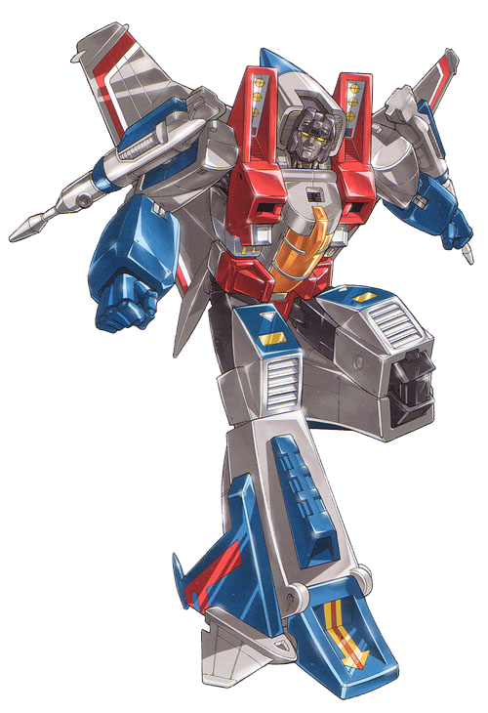
Transforms!
Robots in disguise?
No!
Its just more math…..

Slide 3
translation
0,1,0
When we defined our triangle, we defined all of the points to be a set distance from world 0,0,0.
This works but if we want to move our triangle, we need to shift all of the points by an equal amount
0,0,0
-1,-1,0
-1,1,0

Slide 4
translation
0,1,0 + 1,0,0
Easy enough. Just add or subtract by some vector
We apply this addition/subtraction to all points
0,0,0
-1,-1,0 + 1,0,0
-1,1,0 + 1,0,0

Slide 5
Scale
The same is true for scale. Just multiply of divide the points by a vector (I’m using a uniform vector for uniform scale).
Again you apply this to all points.
-1,1,0 * 0.5,0.5,0.5
-1,1,0

Slide 6
rotation
Rotation is a little more complicated
To rotate around the Z axis, we need to set X to cos Angle * X – sin Angle *Y
And Y to
Sin Angle *X + cos Angle * Y

Slide 7
Rotation around Y
Ok, that’s the rotation for round Z, what about Y
Well rotation around y is
X = Cos Angle *X +sin Angle *Z
Z = - sin Angle *X + sin Angle *z
Ok this is getting complicated.
There must be a better way

Slide 8


Slide 9

What are transforms?
$$\left[\begin{matrix}Scale X & Rot & Rot & Pos X \\ Rot & Scale Y & Rot & Pos Y \\ Rot & Rot & Scale X & Pos Z \\ 0 & 0 & 0 & 1\end{matrix}\right]$$
A transforms is a 4 by 4 matrix
This matrix holds the representation for an objects scale, rotation and position.
We then apply this to our vertex positions as defined in our model file (or triangle in our case)

Slide 10
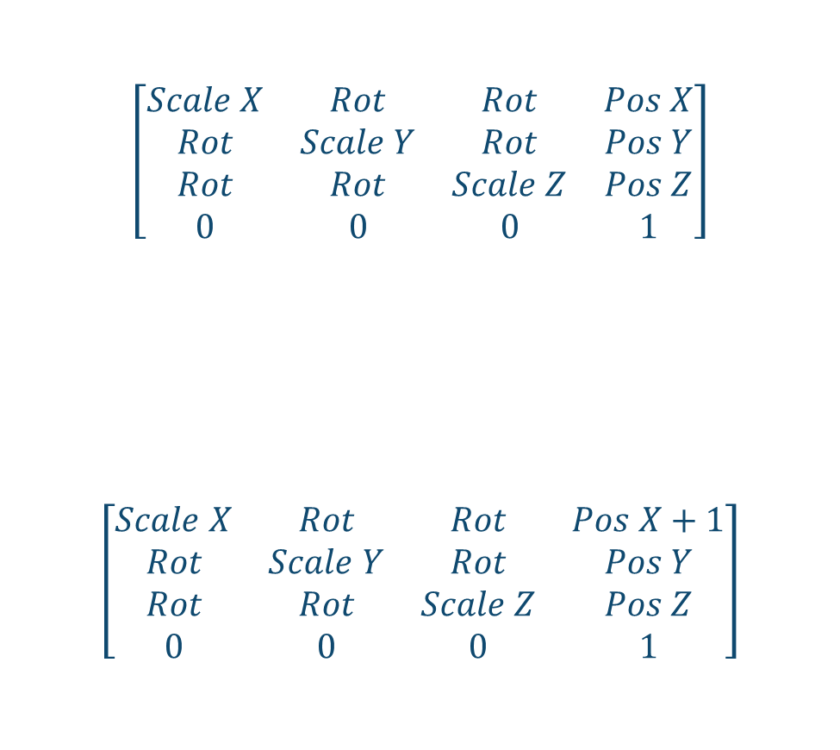
Transform Matrix
$$\left[\begin{matrix}Scale X & Rot & Rot & Pos X \\ Rot & Scale Y & Rot & Pos Y \\ Rot & Rot & Scale Z & Pos Z \\ 0 & 0 & 0 & 1\end{matrix}\right]$$
$$\left[\begin{matrix}Scale X & Rot & Rot & Pos X+1 \\ Rot & Scale Y & Rot & Pos Y \\ Rot & Rot & Scale Z & Pos Z \\ 0 & 0 & 0 & 1\end{matrix}\right]$$
We can change any element in the matrix to affect one part of it, with out changing the other aspects of it.
IE. We can change Pos X by adding 1 and the rotation/scales aspects remain unchanged

Slide 11
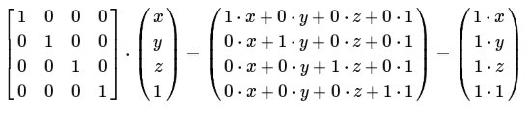
Calculating the result
Our matrix (just scaling)
How dot products work
You don’t need to
GLM and GLSL will do this for you
But just for completeness
The result is the product of our matrix with our point position vector.
We will need to apply this matrix to each point.
I wonder if there is a way to do this easily in openGL ;)
Our point position
The result!

Slide 12
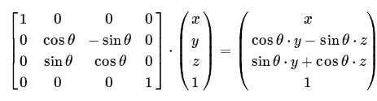
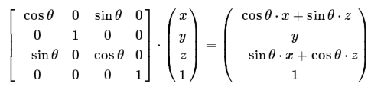
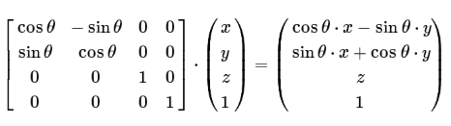
Rotational Matrices
Rotate around X
Rotate around Y
Rotate around Z

Slide 13
What’s the extra 1 for?
Some of you may be wondering “what’s this ‘1’ is for?”.
Homogeneous Coordinates.
“what!?”
You’ll see in a minuet

Slide 14


Slide 15
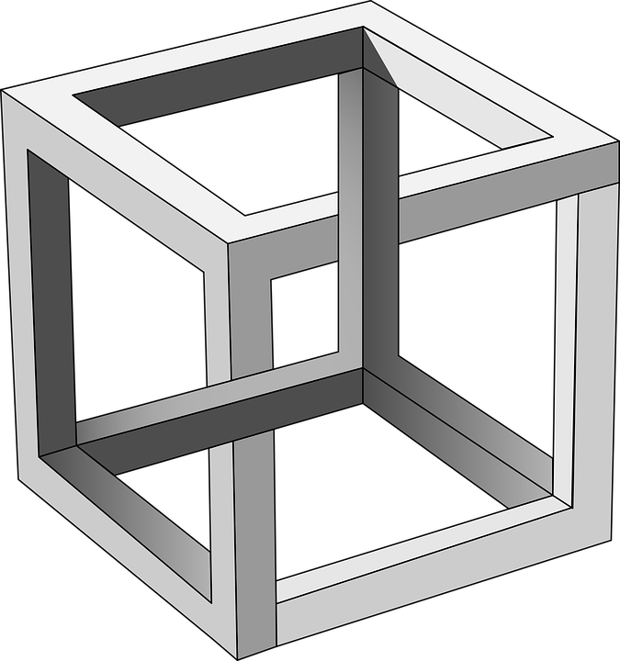
Cameras and Perspective projection

Slide 16
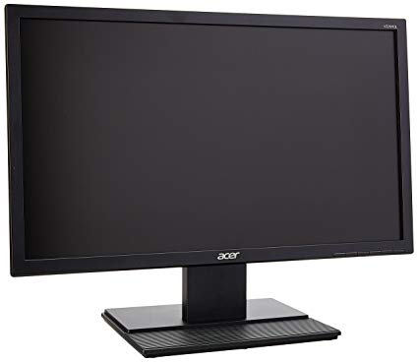
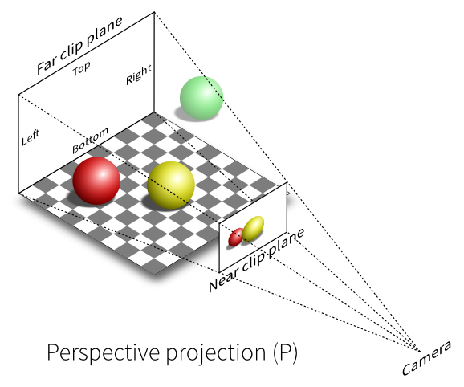

Projection
Projection is the process of taking a representation of an object (3D in our case) and converting it to a 2D representation.
Why do we need to do this?
Because we use a 2D screen to view our 3D world. We must project it to a 2D representation, or we will never see it…
Not until holograms are a thing anyway….

Slide 17
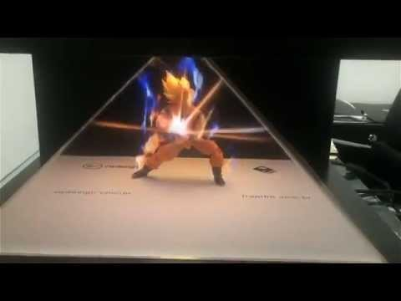
No, this does not count!
It’s a nice illusion but it's just 2D projected on to glass.
Damn cool though.

Slide 18
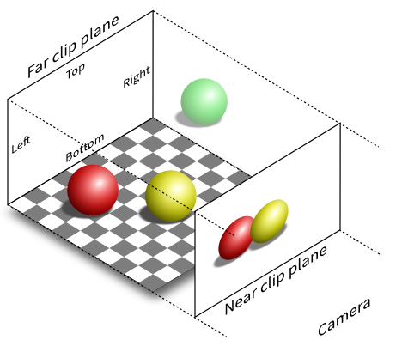
Orthographic projection
Up to now we have been working with orthographic projections
It is a parallel projection in which the projection lines are orthogonal to the projection plane.

Slide 19
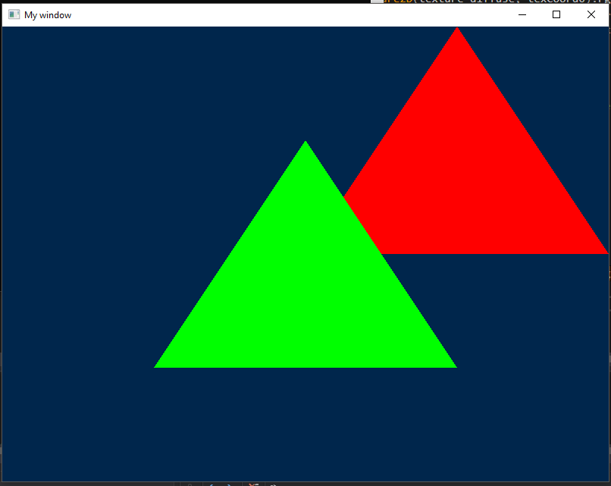
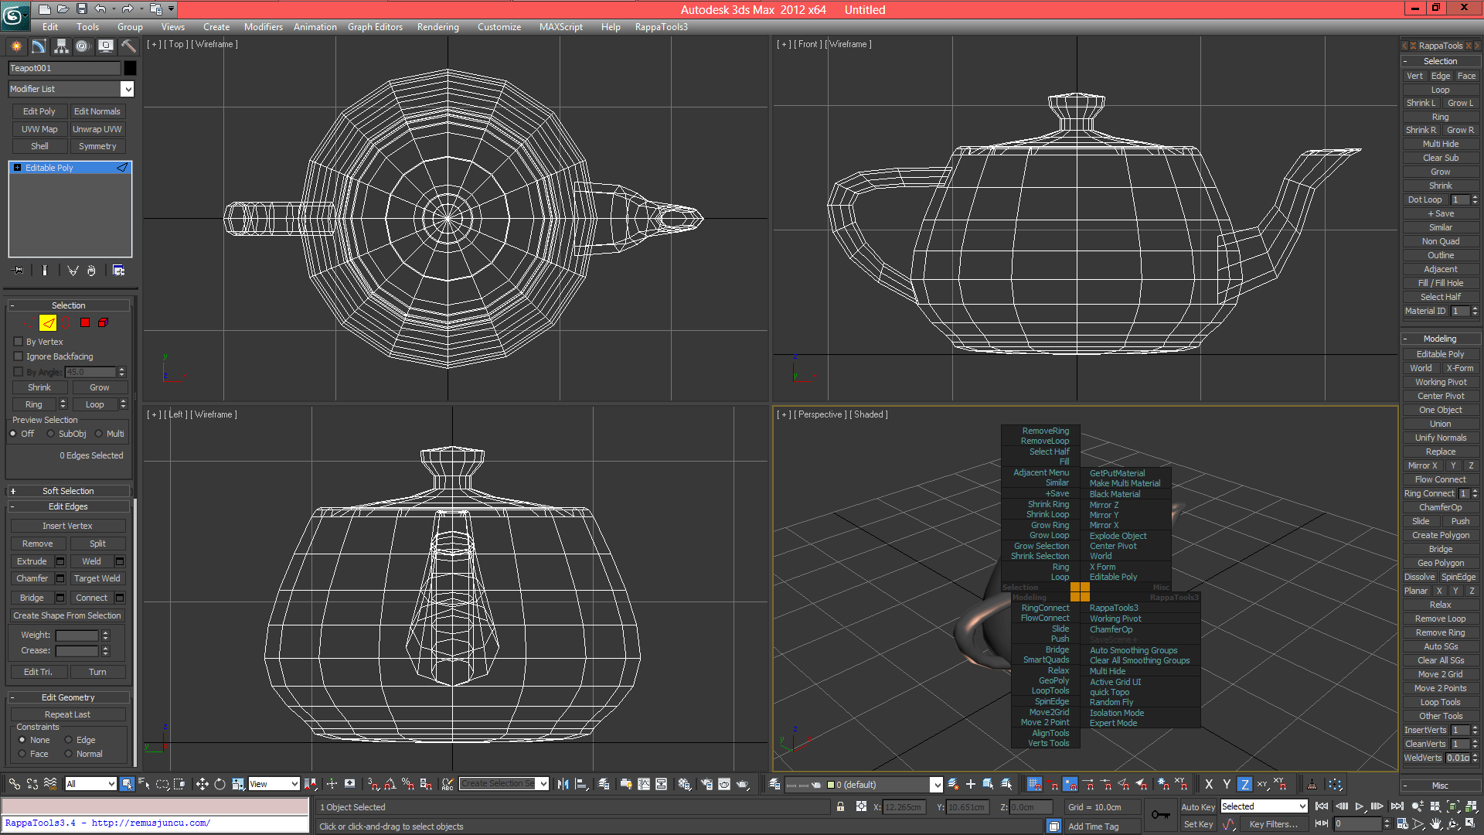
Doesn’t show much in Z
If any of you have tried moving the triangle(s) in z you may have noticed that not much seems to happen.
This is because all z axis are perpendicular to the screen at all times.
This can be useful, 3DS max uses this to aid artists (as modelling directly in 3D space can be challenging).
But its not what we want

Slide 20
We want perspective!
We want to be able to see our objects with depth.
To do this we need to multiply the verts of our mesh by a ‘perspective matrix’

Slide 21
homogeneous coordinates
Remember that rouge ‘1’ in our transform matrix?
That’s a ‘W’ component and we can use it scale all our matrix values, so they are altered according to some value, like the objects distance the camera.

Slide 22
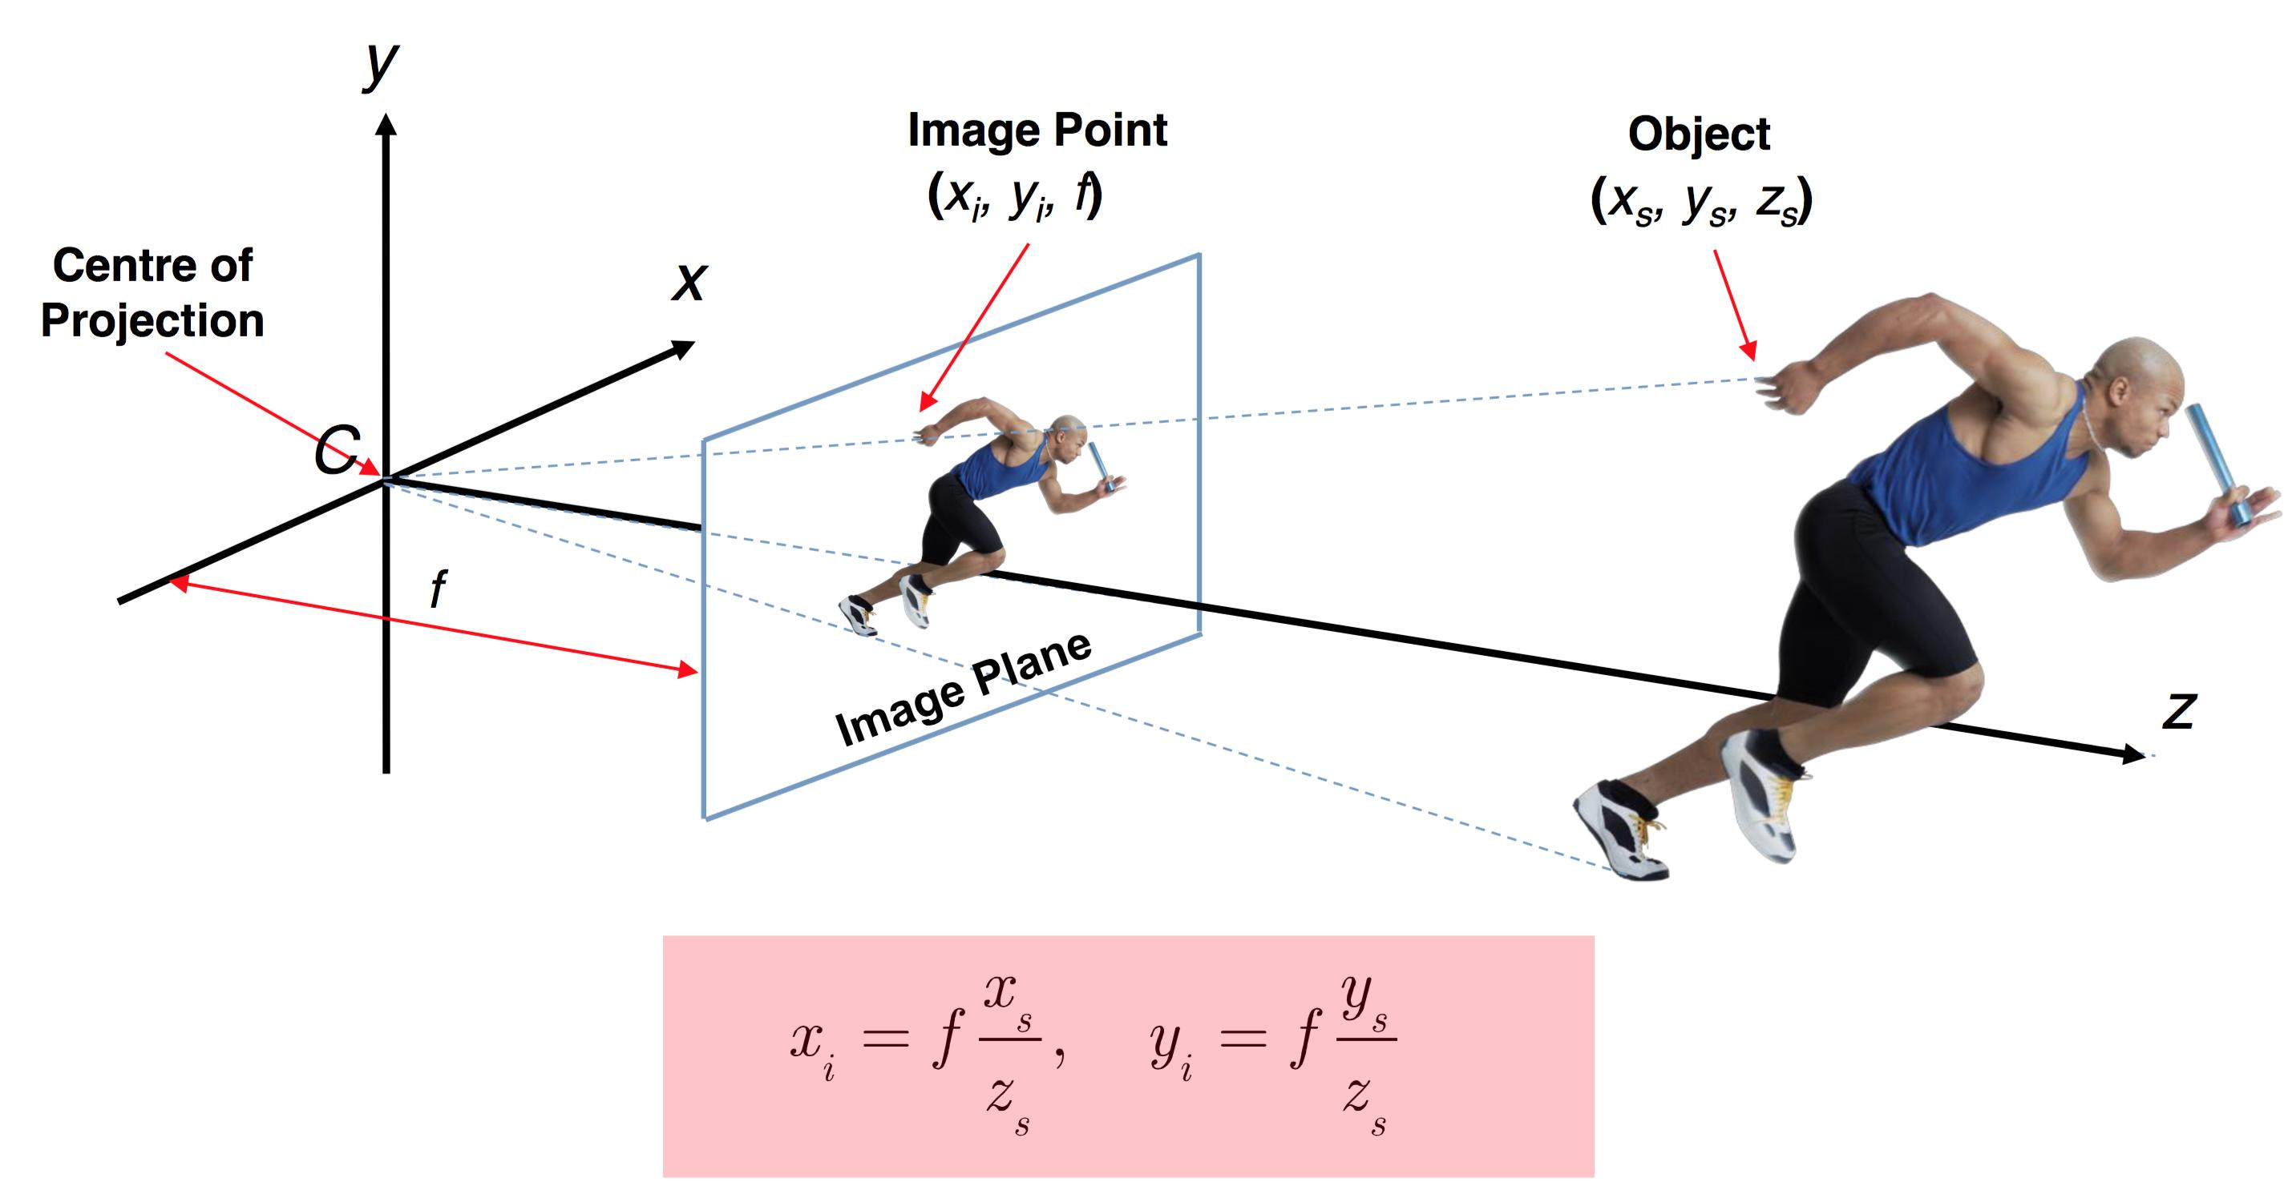
homogeneous coordinates example
In principle what we’re doing is assuming the camera is at world centre and dividing each point on the object by the distance to the camera (which would be our Z axis).
Notes:
This has the effect of drawing all points on the mesh. Down to the size of the image plane (near plane).
But this isn’t how we should do it.
Why?
Because scaling by Z, in a 3d world, makes the transformations non-linier.

Slide 23


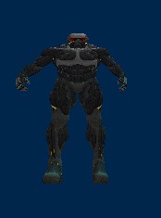
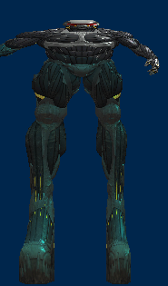
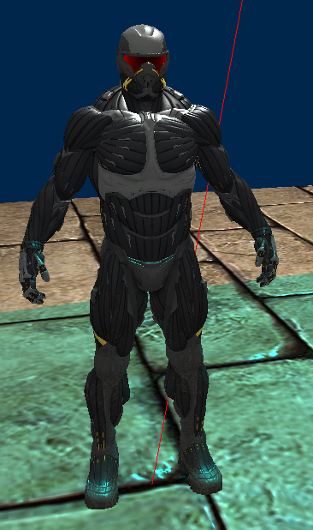
Results of nonlinear transformation

Slide 24
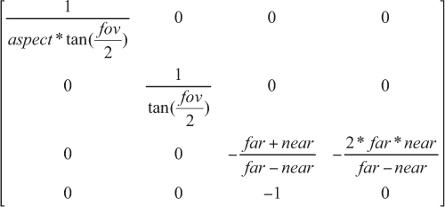
Perspective matrix
We need to generate a perspective matrix or we’ll get strange results.
We don’t need to do this our self’s, glm will make it for us.
All we need is the:
FOV
Aspect ratio
Distance to near plane
Distance to far plane.

Slide 25
What we have so far
We know
What transforms are
How they work (roughly)
How we can use them to project our geometry so it has perspective.
How to generate one.
What we’re missing
The concept of a camera (this will useful for calculating all of our view related stuff)
How we implement all of this

Slide 26
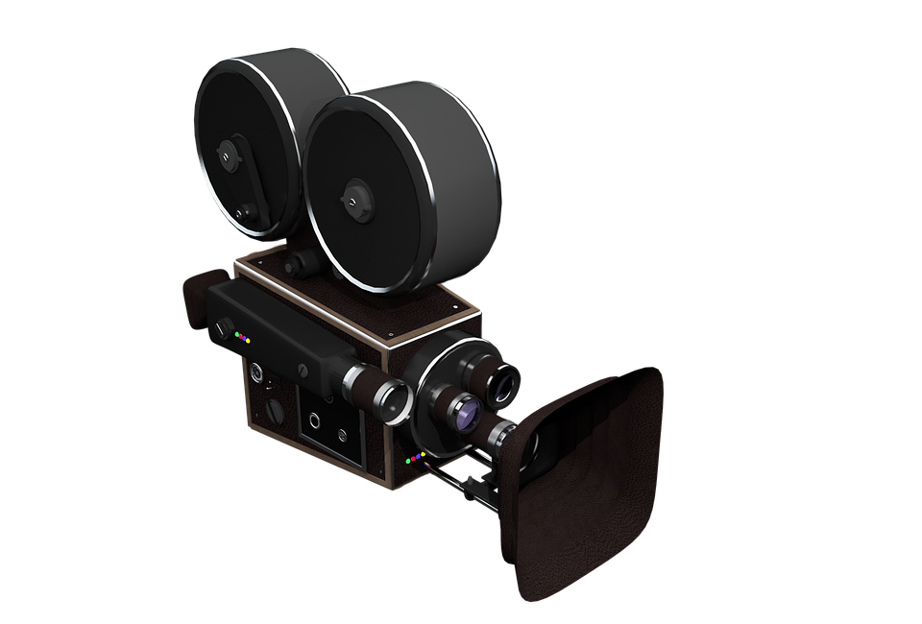
Cameras

Slide 27
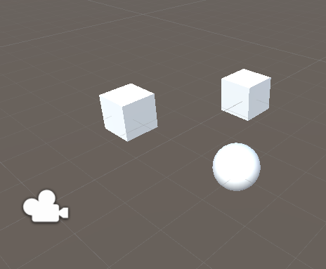
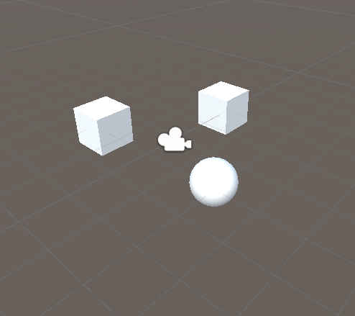

The world and movement
Before we start talking about cameras in 3D space we should talk about how objects move in 3D
How we think about cameras and movement in a 3D. We assume it works like real life, the camera moves through space to its new location.

Slide 28
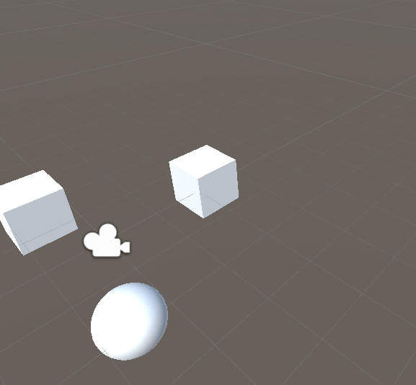
Not exactly
When we move our camera, what's actually happening is that we are subtracting our cameras position from our objects transform.
This means that we are effectively moving the world around the camera.

Slide 29
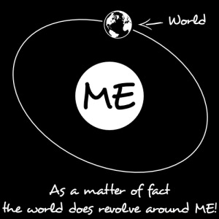
This is also true for rotation

Slide 30
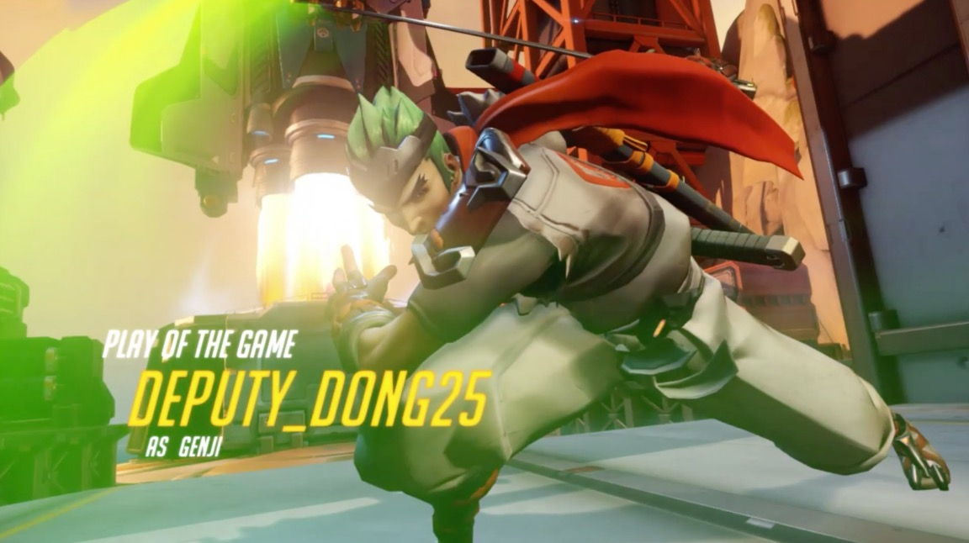
MVP
Ummmm no…. Not this kind of MVP.

Slide 31
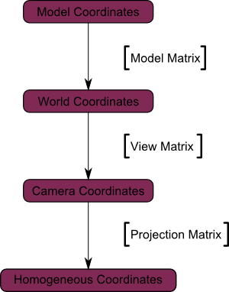
Model View Projection
Our Model Transform
This is the process of converting from model(mesh) coordinates to our Screen Coordinates.
These are matrices, all combined (ORDER MATTERS!)
Arrrhh nafff. We’re missing this
Our perspective Projection Transform
Our screen

Slide 32

View matrix
Subtract pos from target
Cross world up with cam forward
Ok lets make this quick
Our camera is useless unless we know which way it is facing. (this will define how we rotate our world so we can view it).
To work out which way it is facing, we need to know where it is, what its looking at and the cameras up direction.
Pass our cam pos, target and cam up to lookAt()
Returns a matrix 4 (mat4 in glm). This is our view matrix.
Easy!

Slide 33
What we need for a camera
A class that will hold the near and far plane values
The cameras “fake” position
The field of view
The screens aspect ratio
View matrix
Cam position
Cam rotation

Slide 34
What we need for a transform
Not much is needed here. Glm has most of it ready for us.
A wrapper class that will help us with common tasks
Vec3 for rotation
Vec 3 for position
Vec 3 for scale
A function to calculate our model

Slide 35
What do we do with all of this?
We pass it through to our vertex shader and make it apply to all our verts
This means we will need to get variable data into our shaders…. This should be fun :D
Its easy, see the tutorial for more

Slide 36
Questions?

Slide 37
Get on with it!

